Slide 1
Point Hudson Jetty
Animal relocation project

Slide 2
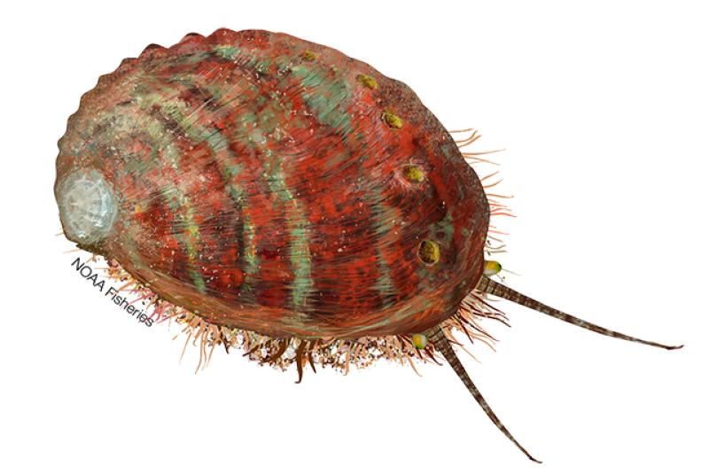
Welcome
Run of the day
Intros
Project overview - why are we doing this?
Animals - care, priorities, species of concern
Dive Days - schedule, safety, logistics
AQ tour
Sign up for dive days
11:15 Under the pier
1:00 Lunch at Point Hudson

Slide 3
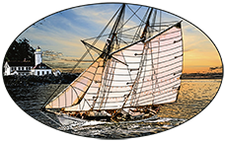
Project Overview
Jeanette Widener, Port of Port Townsend

Slide 4
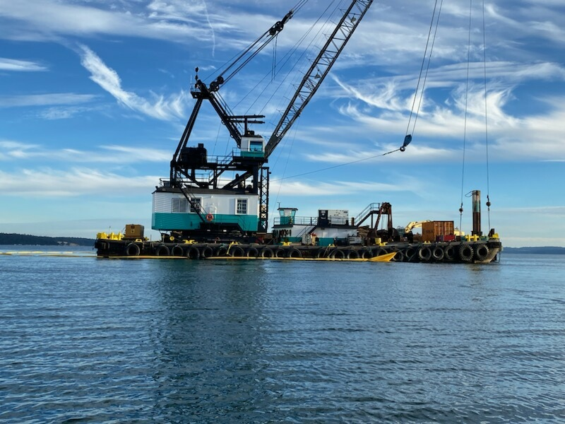
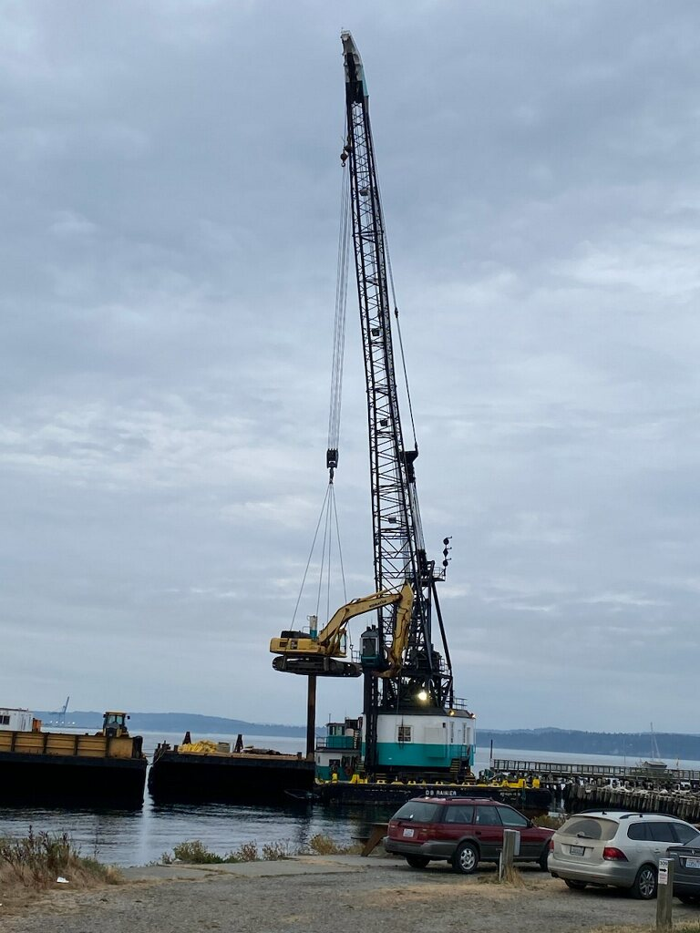
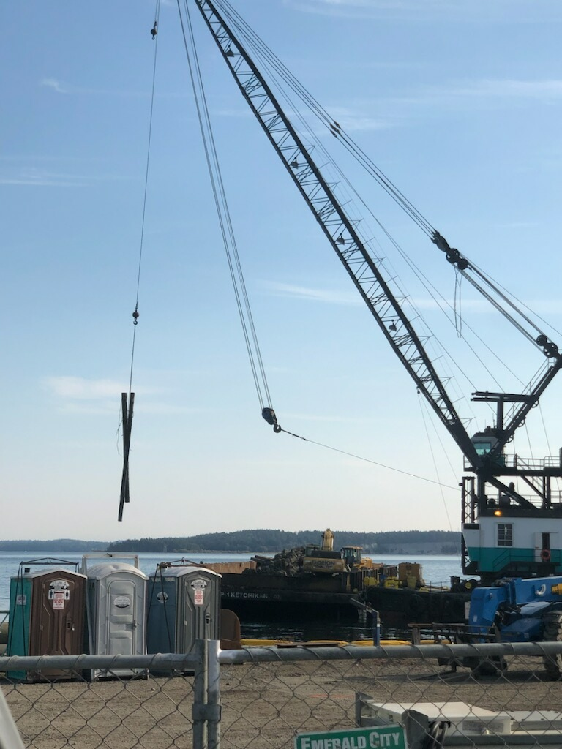

Slide 5
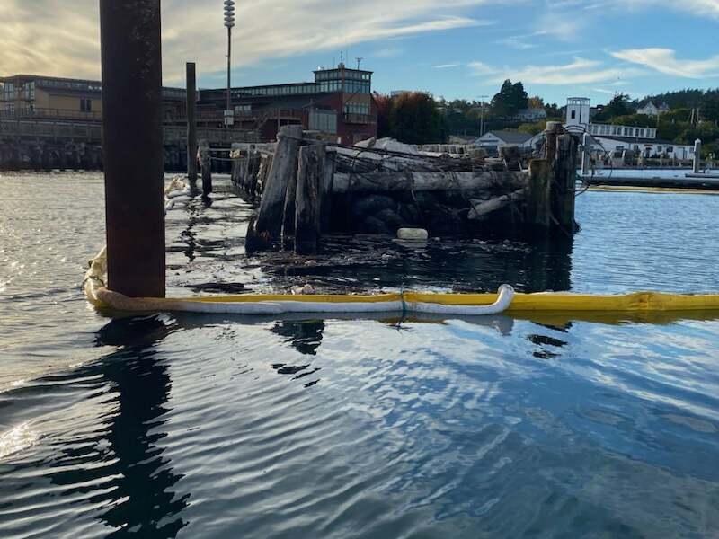

Slide 7
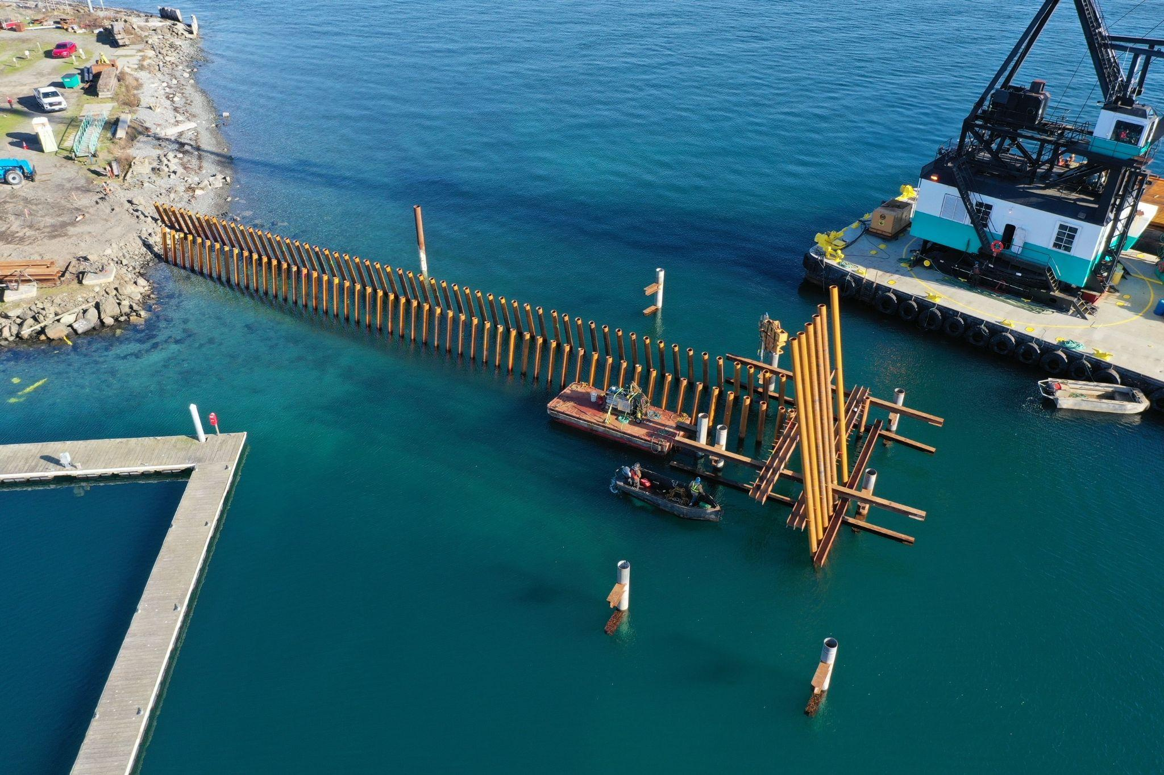

Slide 8
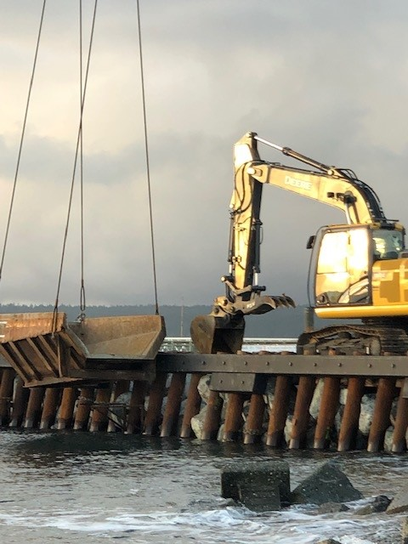

Slide 9
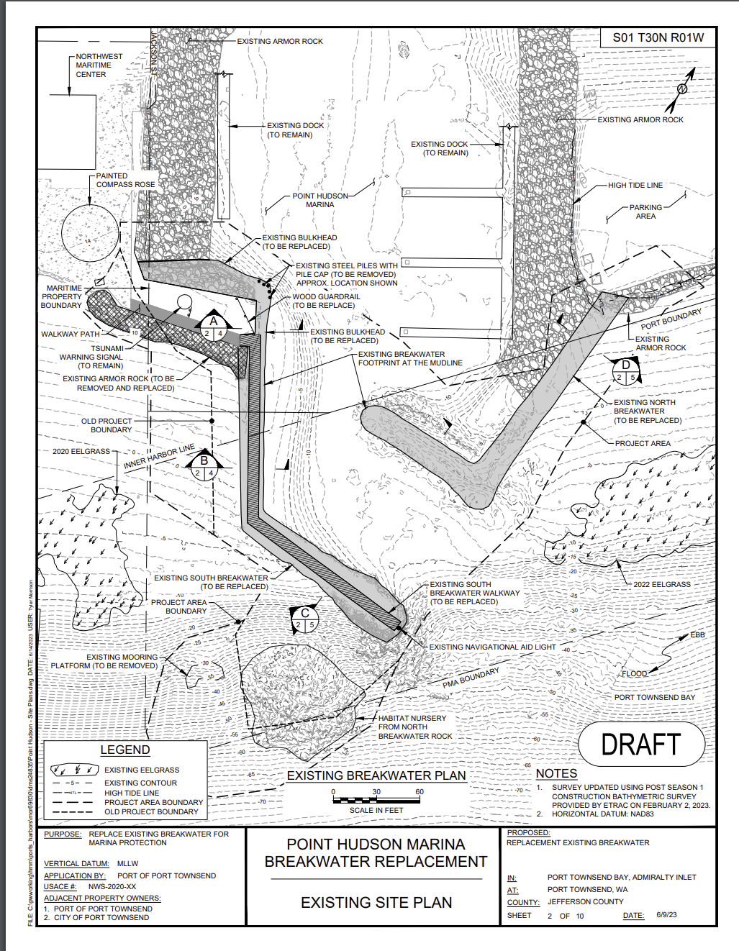

Slide 10
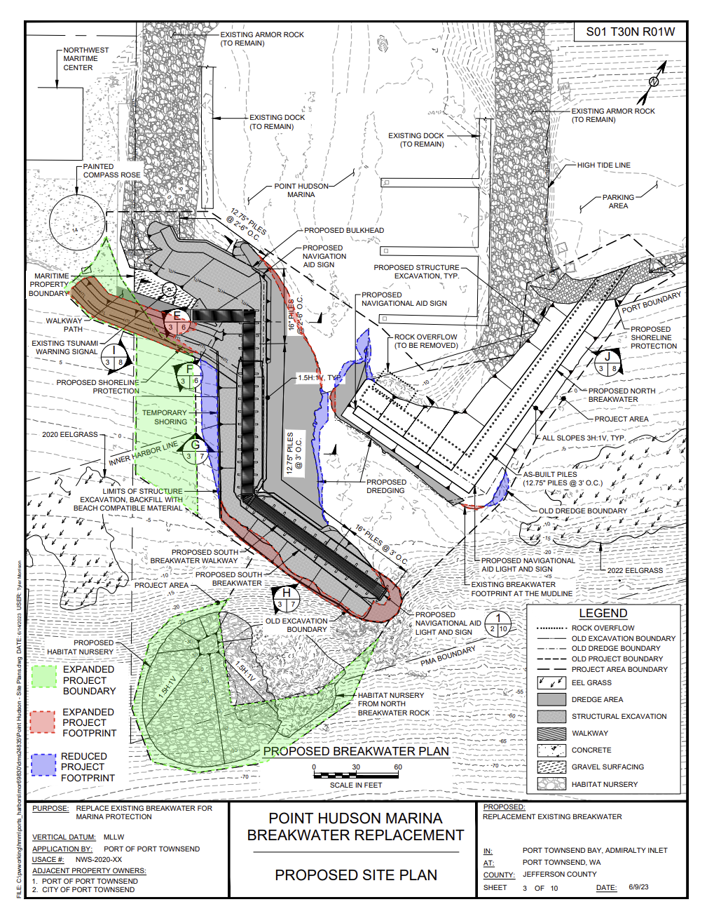

Slide 11
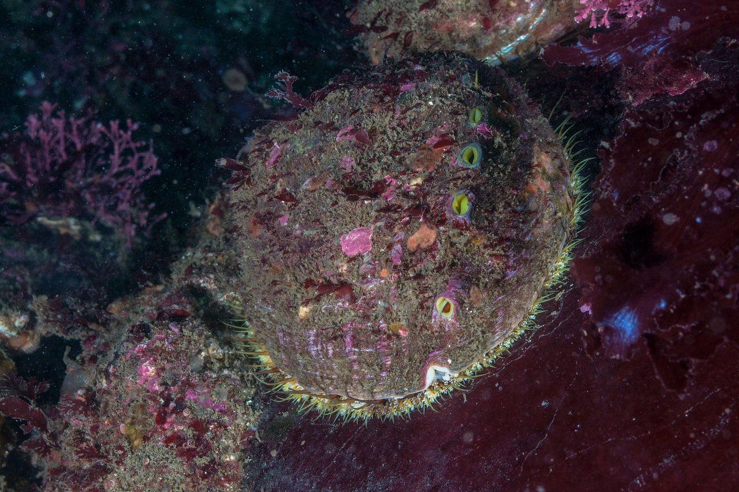
Abalone
Matt Hoehn, WDFW
Image: NOAA

Slide 12
Video from WSA
https://portofpt.com/engineering/

Slide 13
Priority Animals
Individual:
Sea stars
Snails
Nudibranchs
Sea cucumbers
Anemones
Crabs (small)
Gumboot chitons
Abalone - with training
Don’t need to move urchins

Slide 14
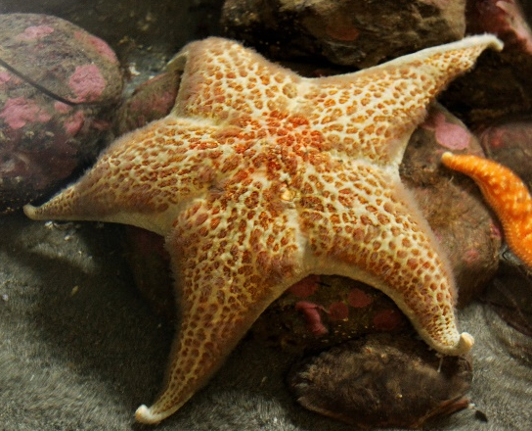
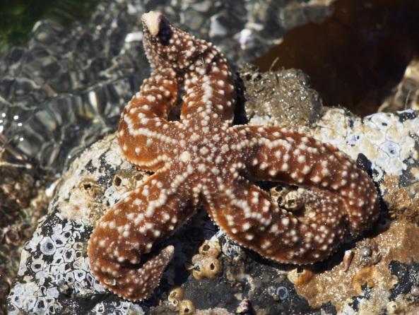
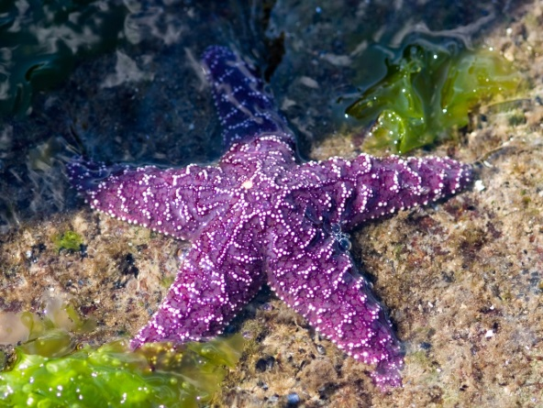
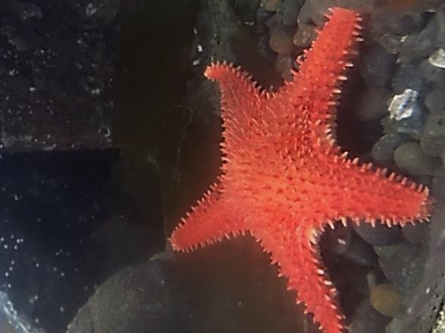
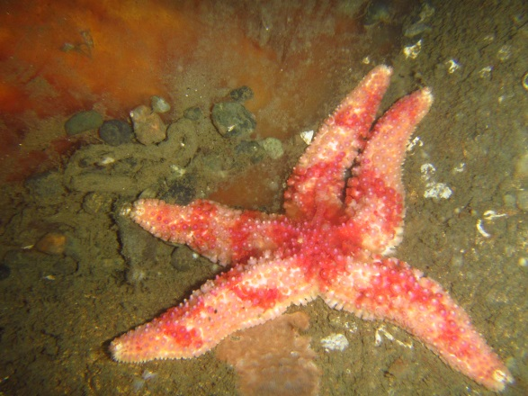
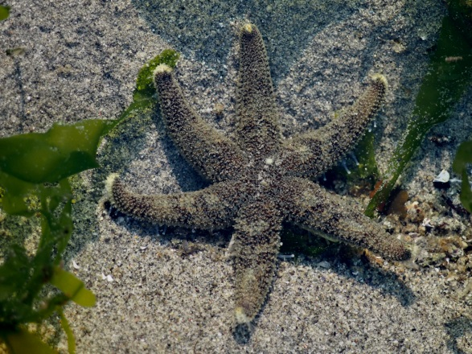
Sea Stars

Slide 15
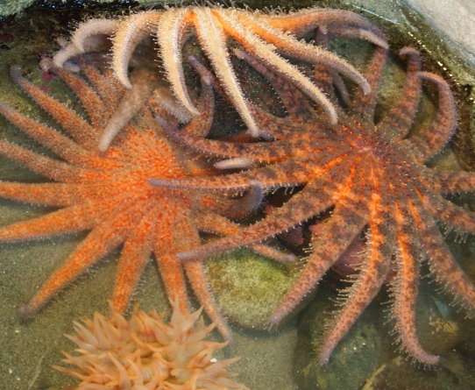
Sunflower stars

Slide 16
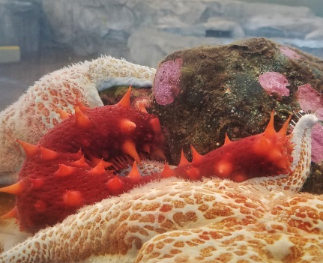
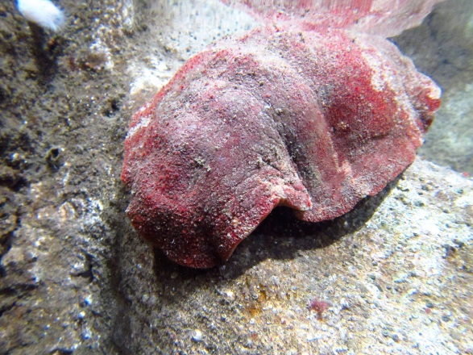
Big red things - Giant Sea Cucumber and Gumboot Chiton

Slide 17
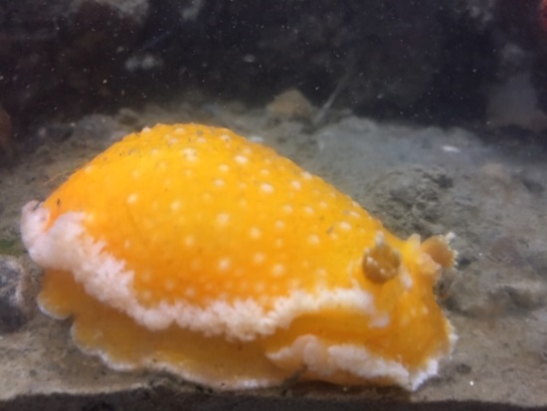
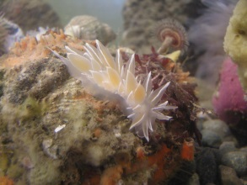
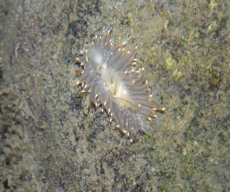
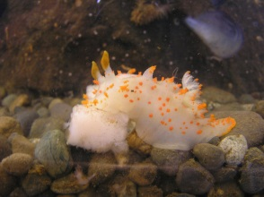
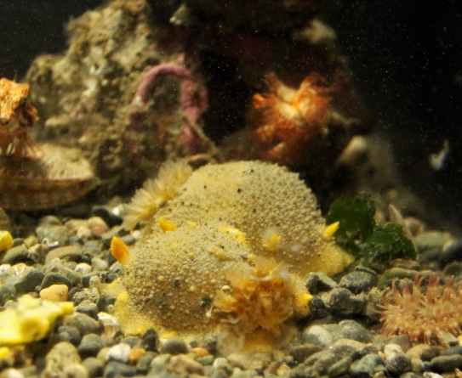
Nudibranchs

Slide 18
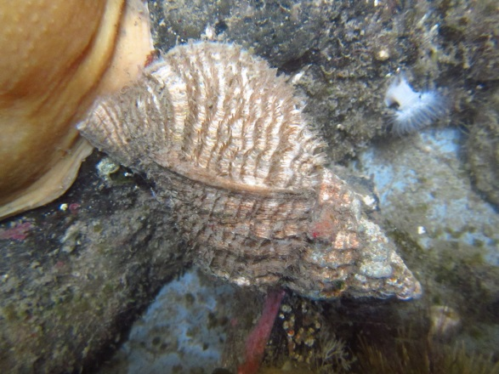
Snails

Slide 19
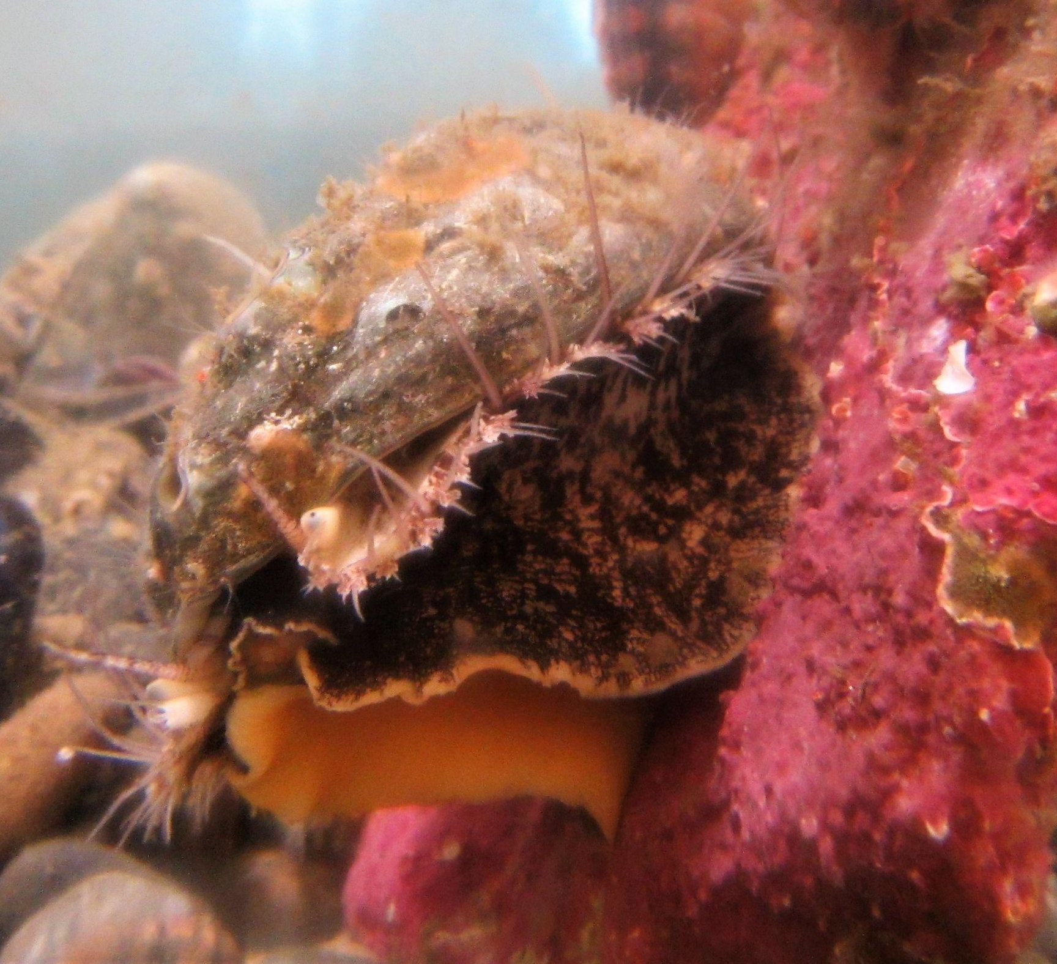
Pinto abalone

Slide 20
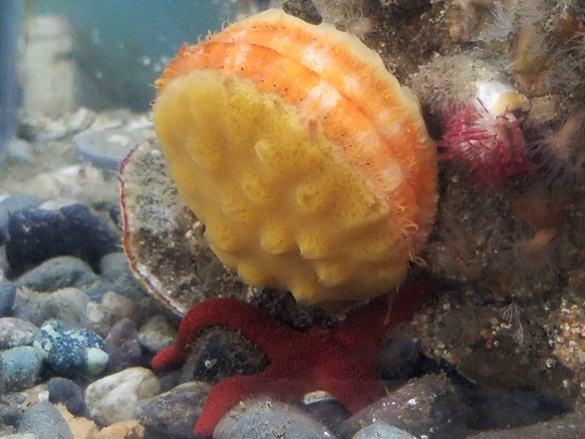
Scallops, mussels

Slide 21
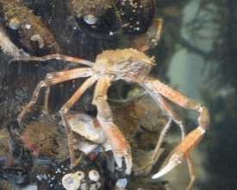
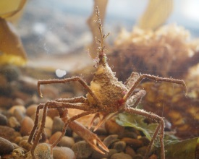
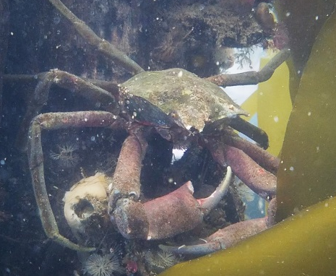
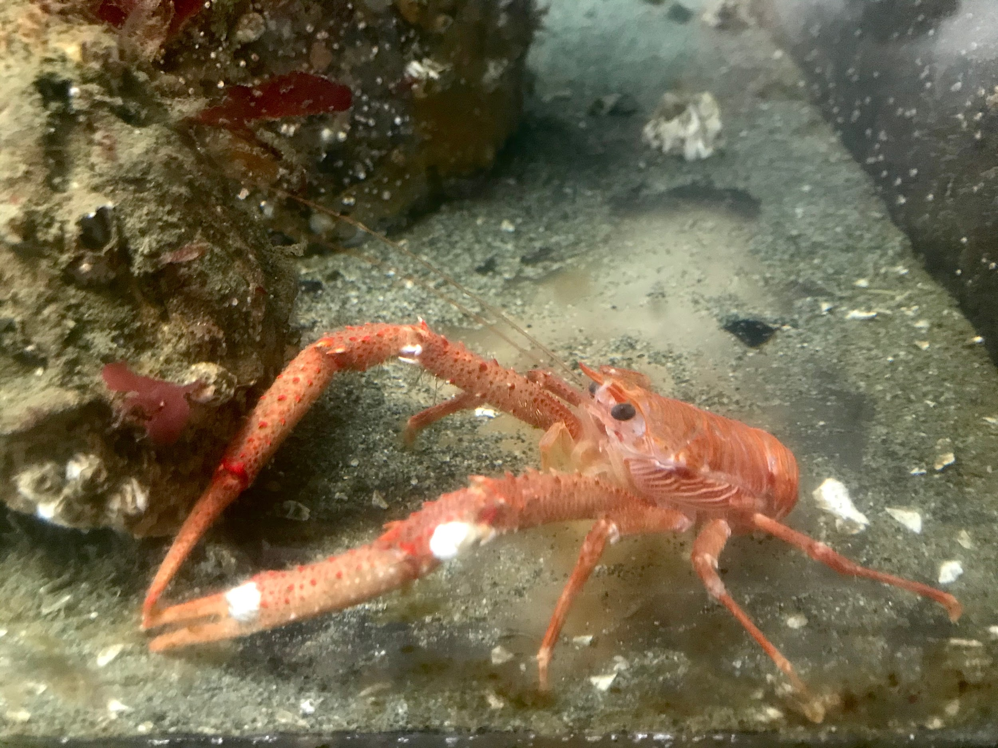
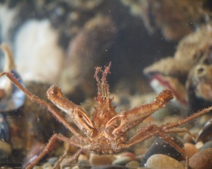
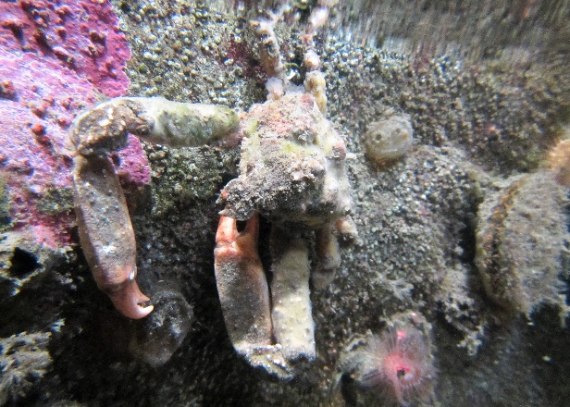
Crabs
Wendy Feltham
Notes:
Spider crabs, sharp nosed crab

Slide 22
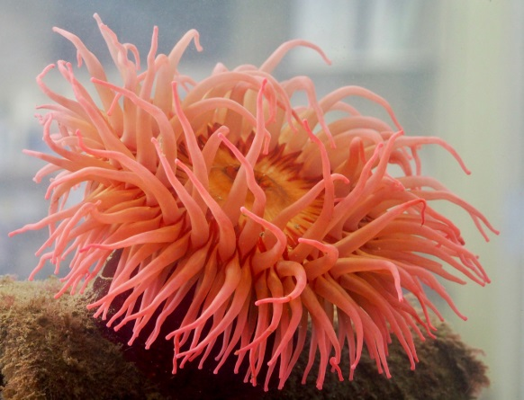
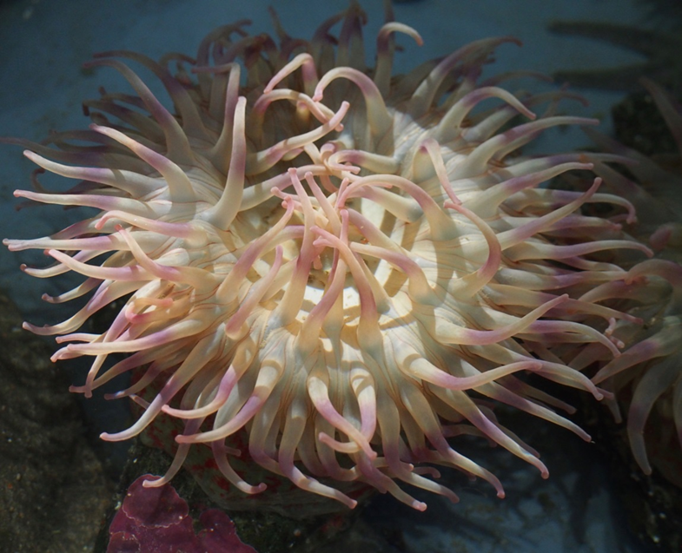
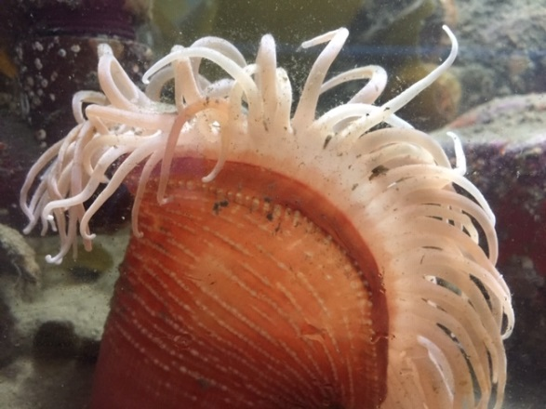
Anemones

Slide 23
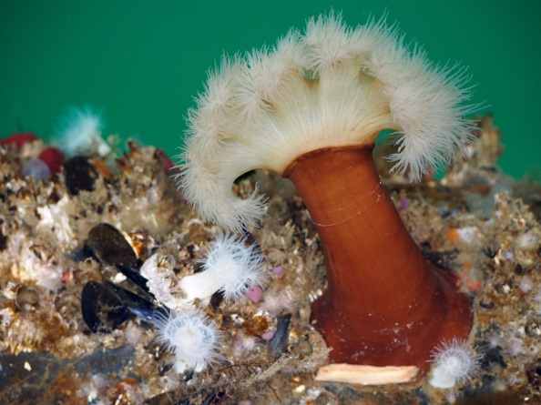
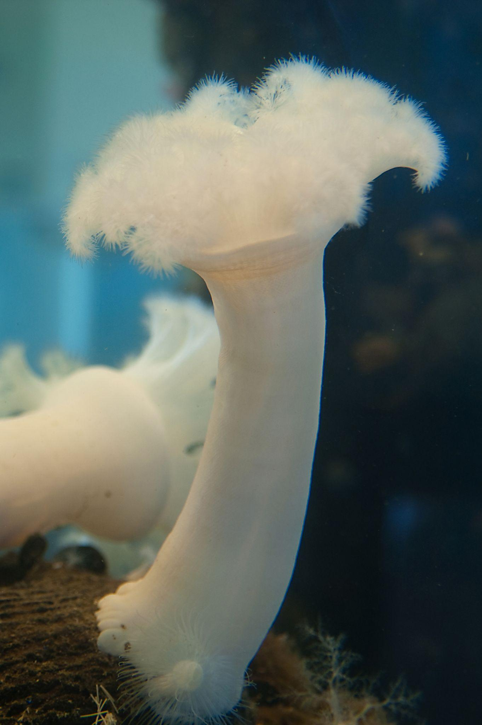
Plumose anemone?
Metridium gigantium

Slide 24
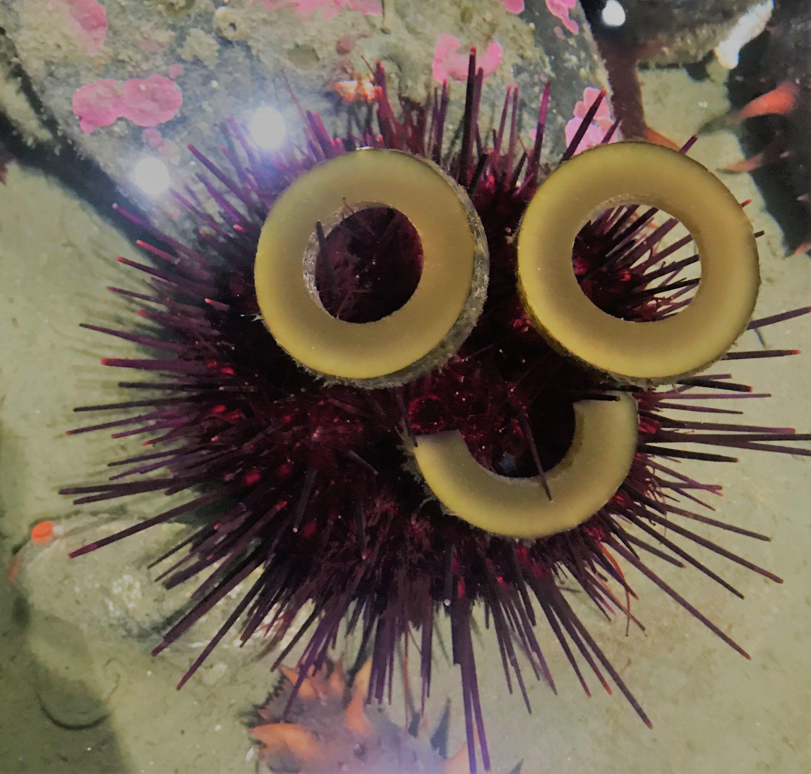
Urchins??

Slide 25
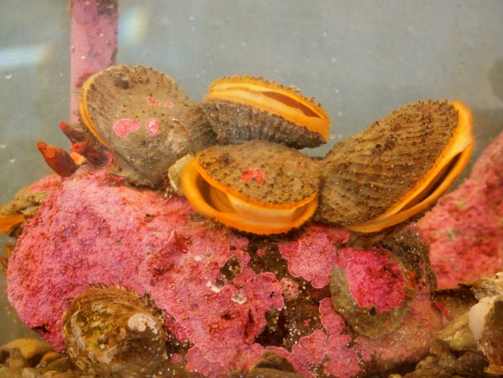
Rocks
Some animals can not be moved individually. Cobble sized rocks can be moved.

Slide 26
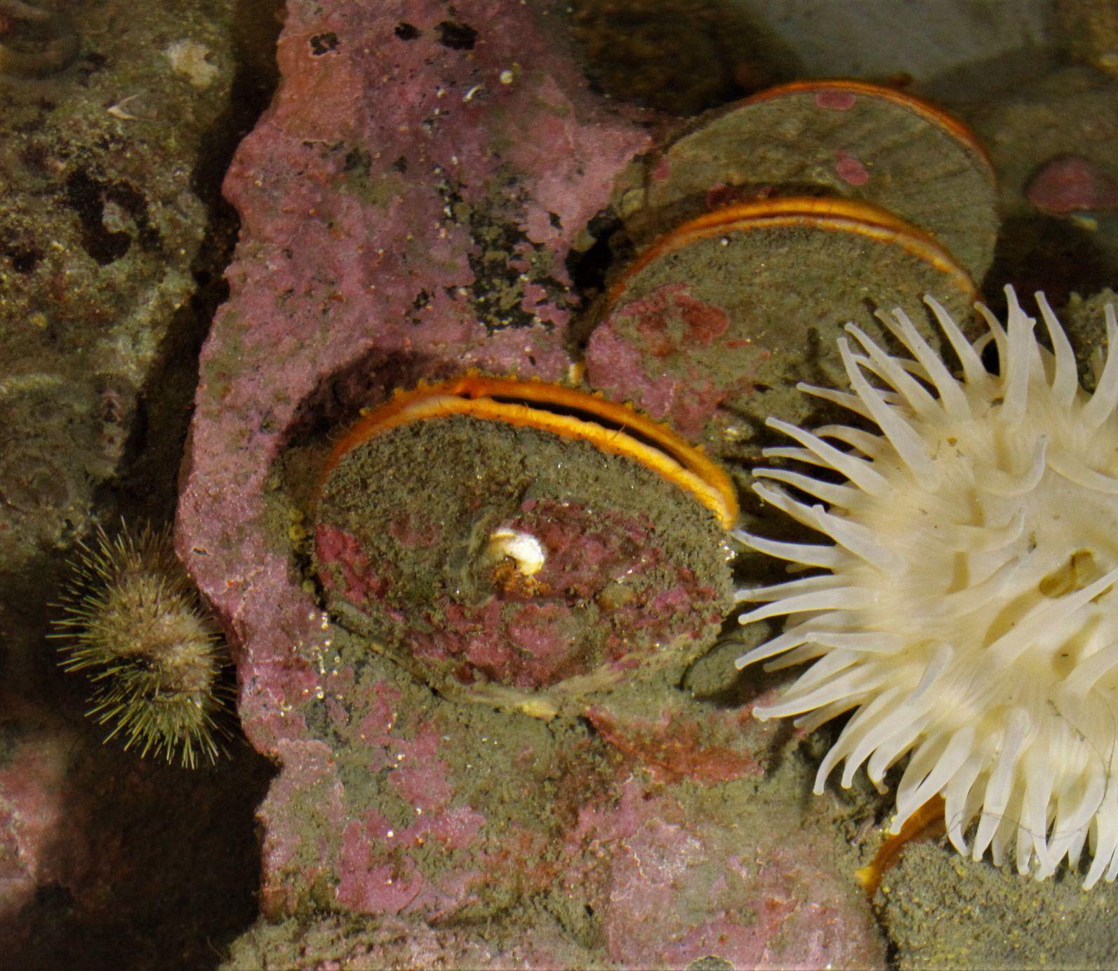
Scallops - Giant Rock and Pink

Slide 27
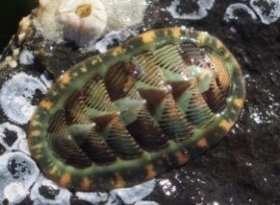
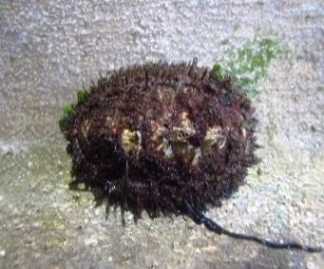
Chitons

Slide 28
What to think about when moving animals
Rhoda, Ali, Randy

Slide 29
Dive Day Logistics
Parking
Check in and waivers
Dive partners
Splash times
Location - try to move from one depth and place a similar depth
Safety considerations
What to do in case of an emergency
Check out and report out (what did you move? )

Slide 30
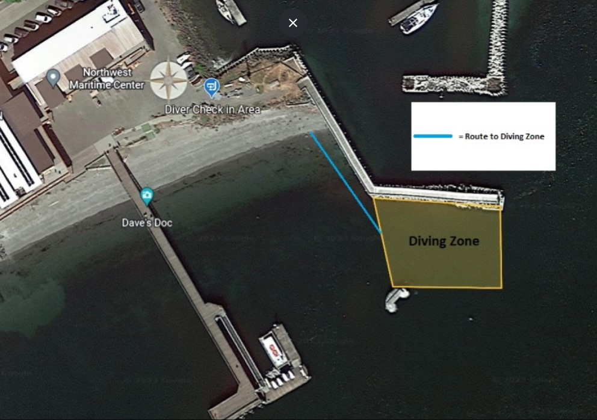

Slide 31
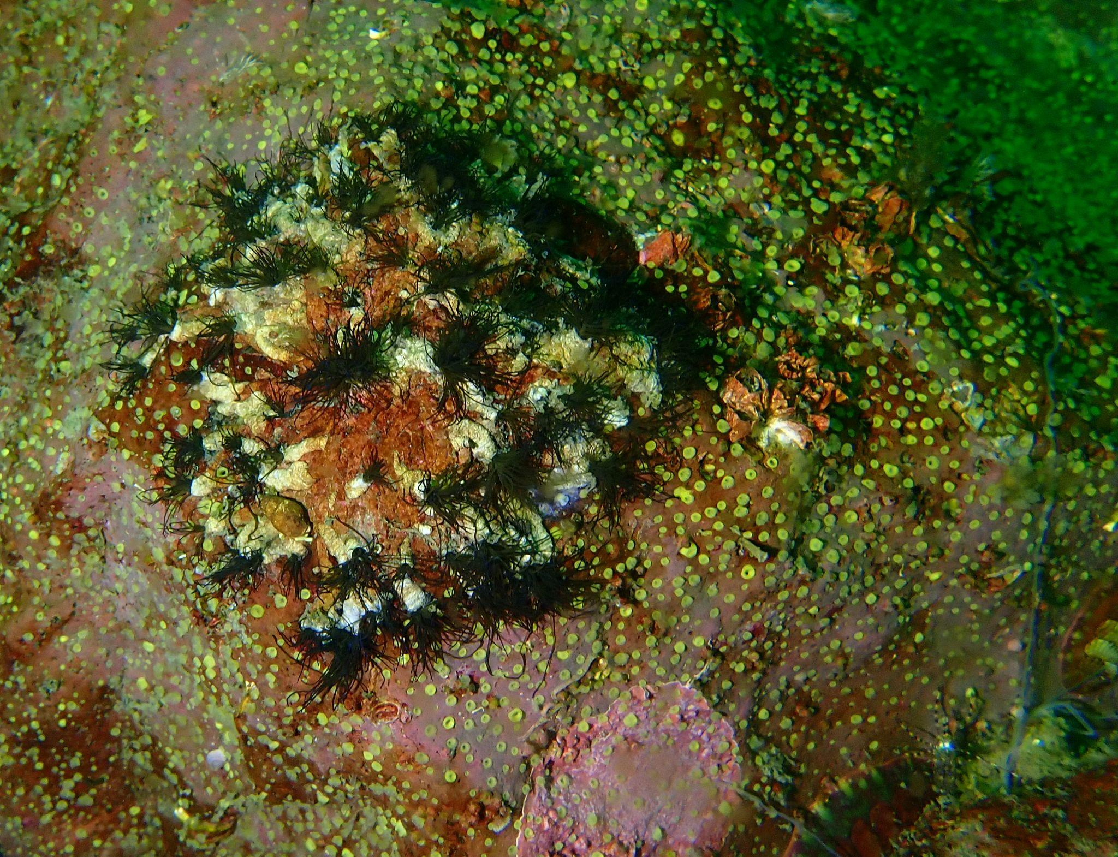
Questions?
Photo: Rhoda Green

Slide 32
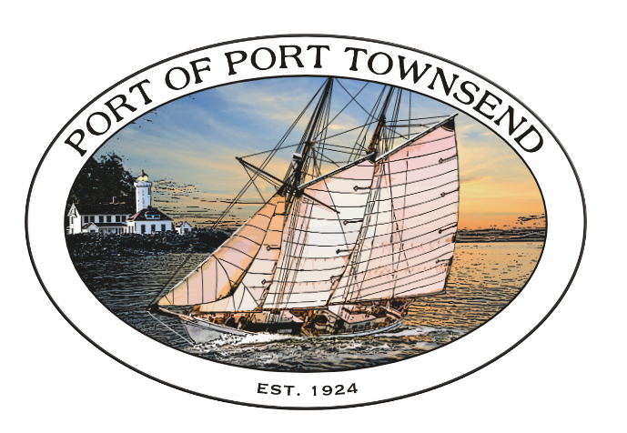
Thank You!
Aquarium Tour
Sign up for dive times
Head outside
Octopus Gardens

Slide 33
